Slide 1
Information Assignment
Abdul Hafeez

Slide 2
Information About Project
composer create-project laravel/laravel HafeezEx dev-develop
php artisan serve
php artisan make:controller MyController
Create Page & Pass value from controller to view

Slide 3
Create Pages & Add Assets Files
View Folder
Layouts
app.blade.php
View Folder
Pages
index.blade.php
about.blade.php
services.blade.php
Public Folder
Assets
Css
Js

Slide 4
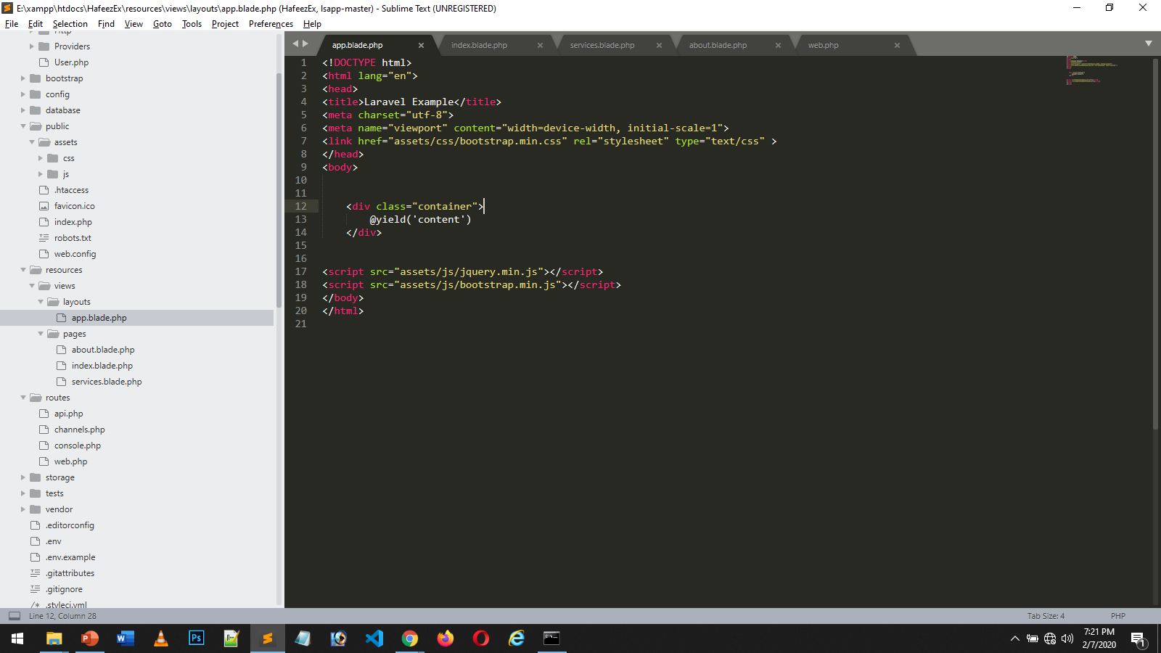

Slide 5
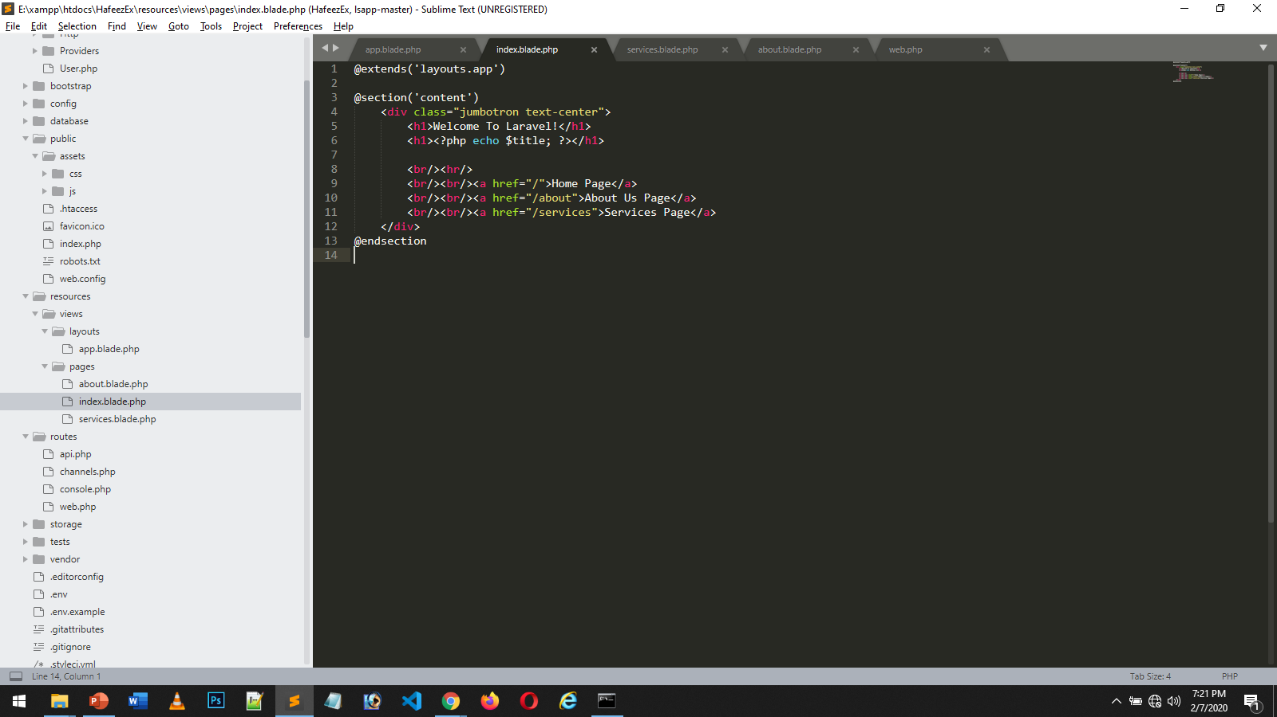

Slide 6
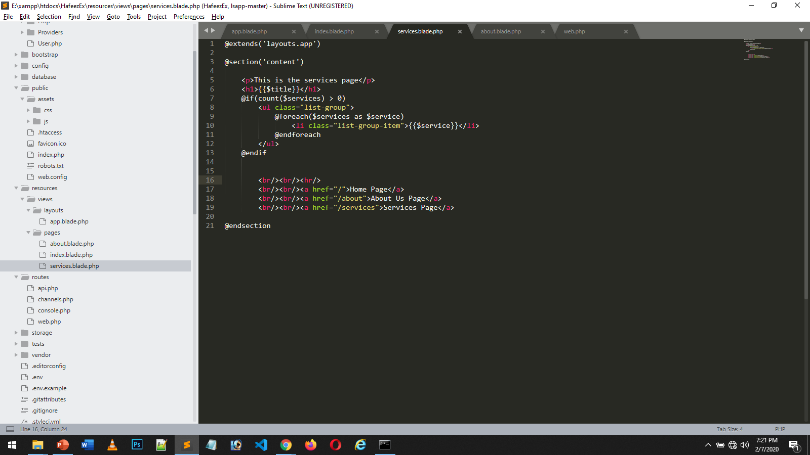

Slide 7
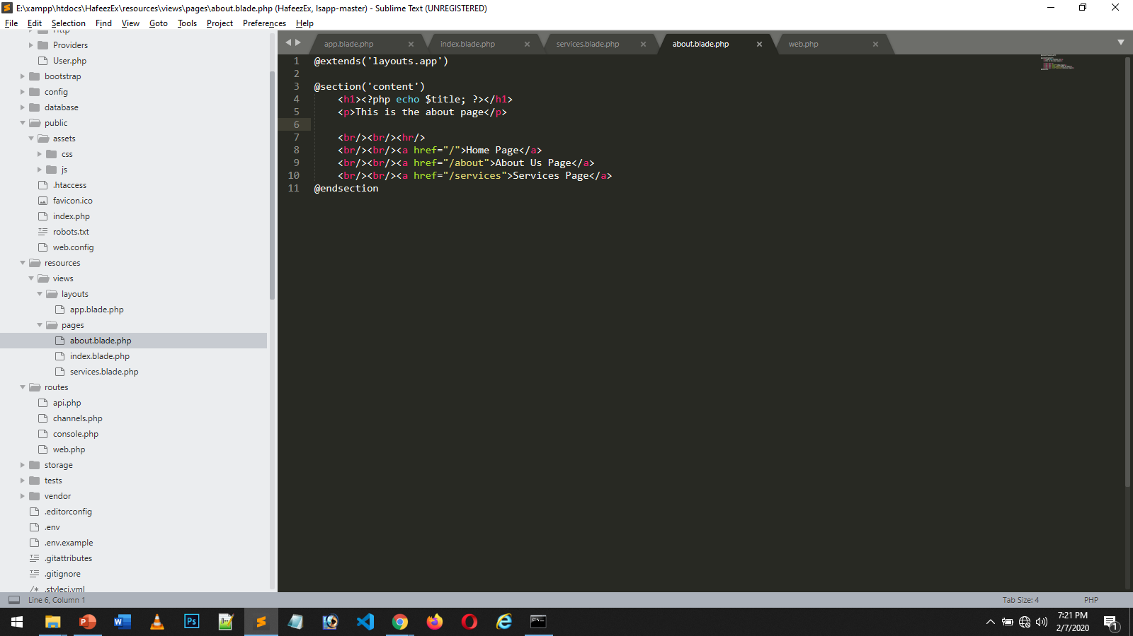

Slide 8
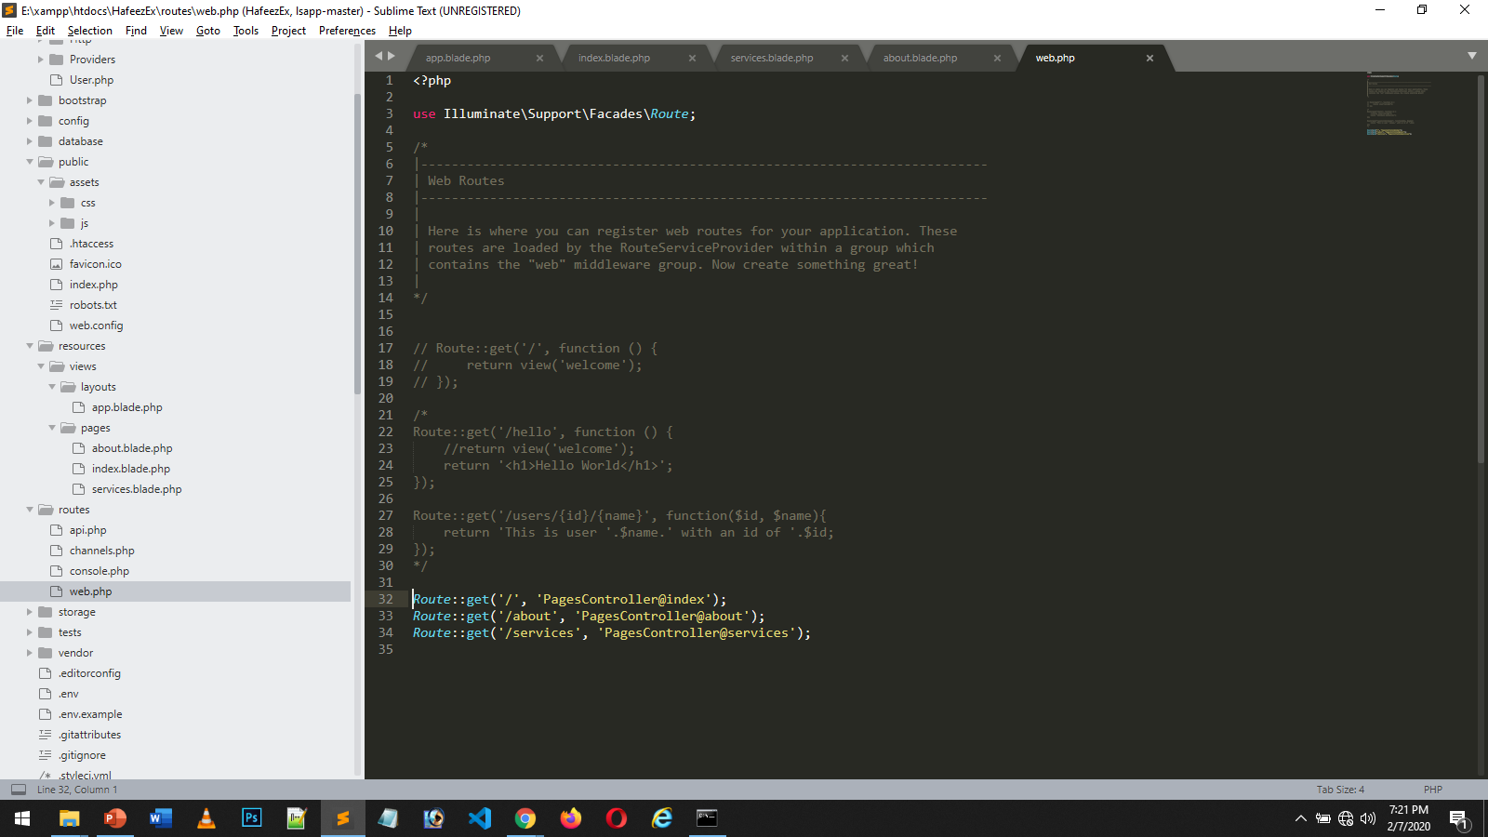

Slide 9
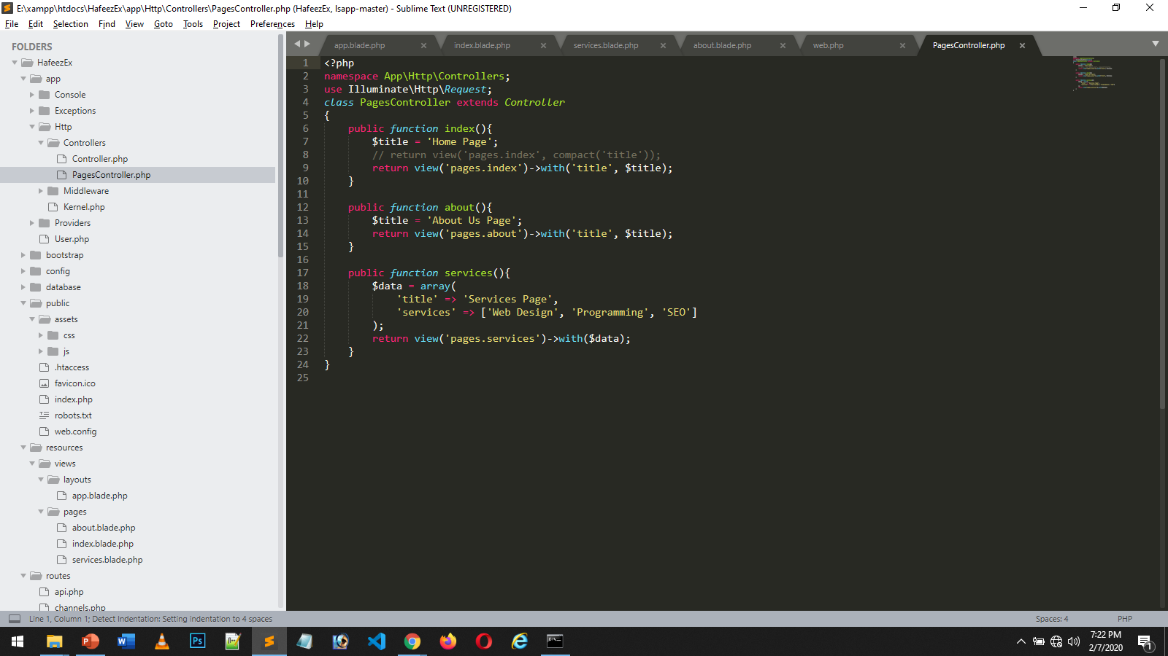

Slide 10
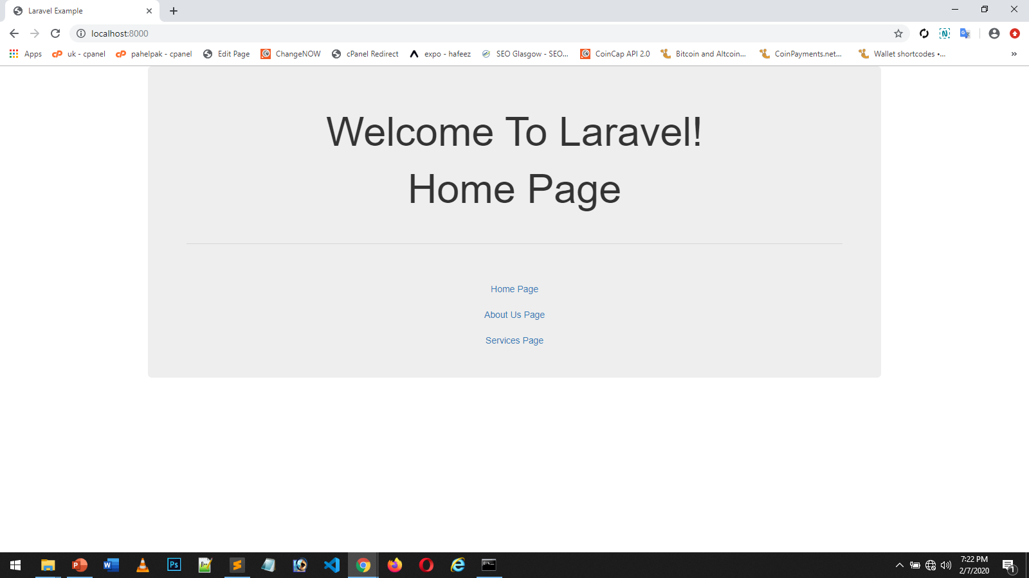

Slide 11
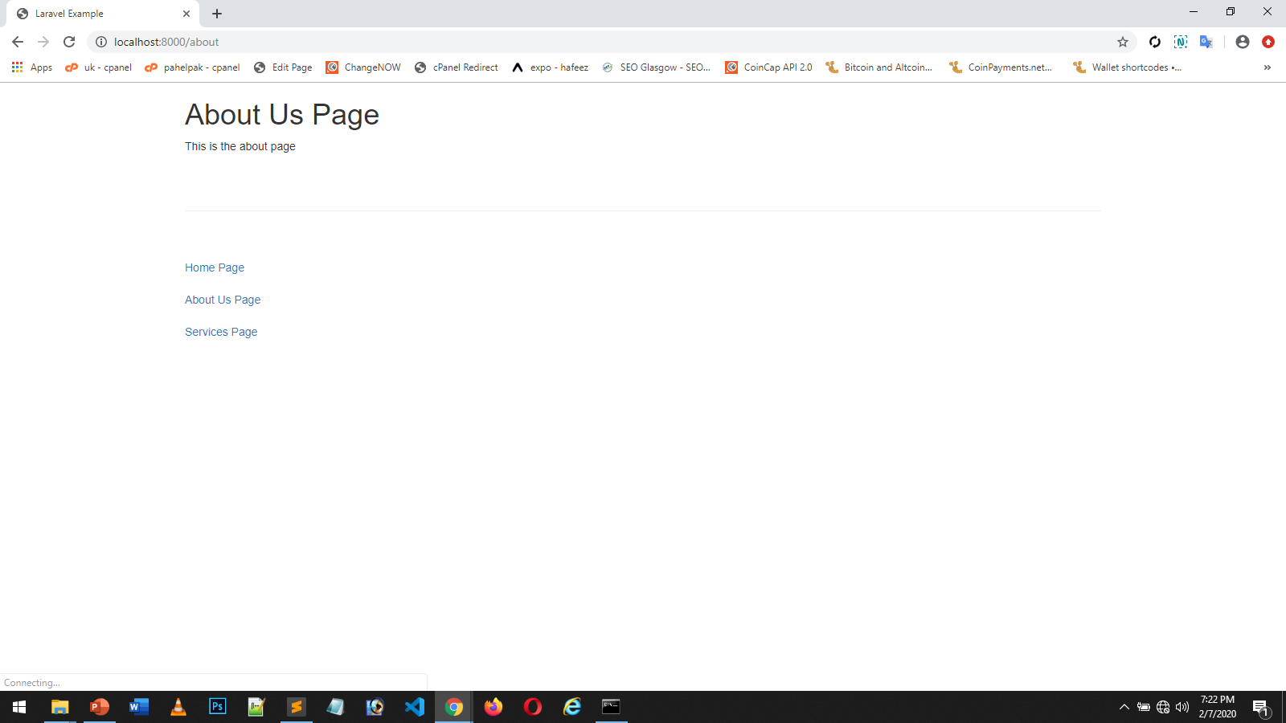

Slide 12
